Slide 1
Business Tax
Tutorial 4

Slide 2
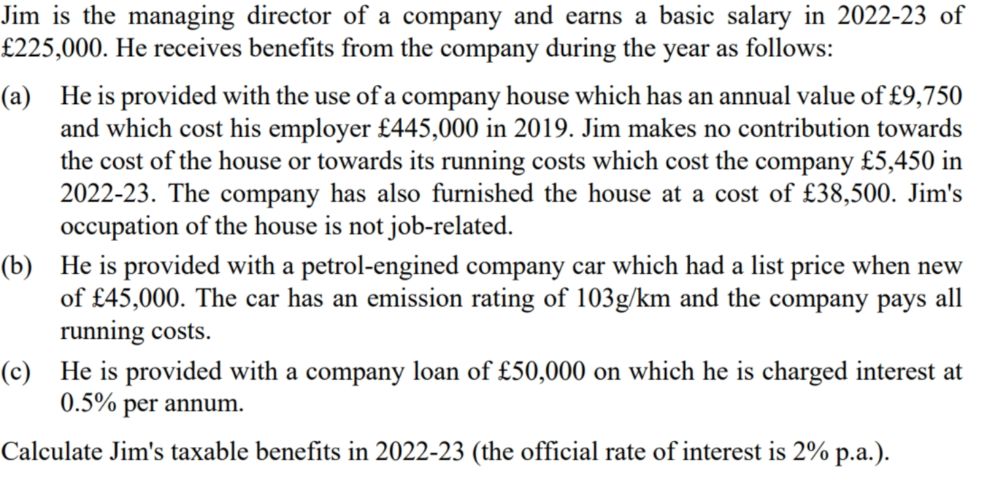

Slide 3
